Slide 1

Spreadsheet Project:
AstroSage Analysis
SHUBHAM
10/09/2024

Slide 2
About AstroSage
. AstroSage is one of the most authentic astrology destinations for not only those who are seeking astrological assistance, but also for high-level astrological research and development on wide scale.
.It is a prolific astrological source for people to help them out from mundane questions to specialized queries. Our aim is to ameliorate those who are facing problems and betterment of humanity using divine science of astrology.
.Keeping this all-embracing vision in mind, renowned astrologer Pt. Punit Pandey embarked AstroSage.com in year 2000 to put astrological wisdom for help of ailing mankind.
.He is an astute and experienced astrologer himself and understands how different astrological systems like KP, Lal Kitab and Nadi etc can be applied into different situations to get practically viable results. The AstroSage team that works in his guidance consists of many expert astrologers pertaining to different schools of astrology.

Slide 3
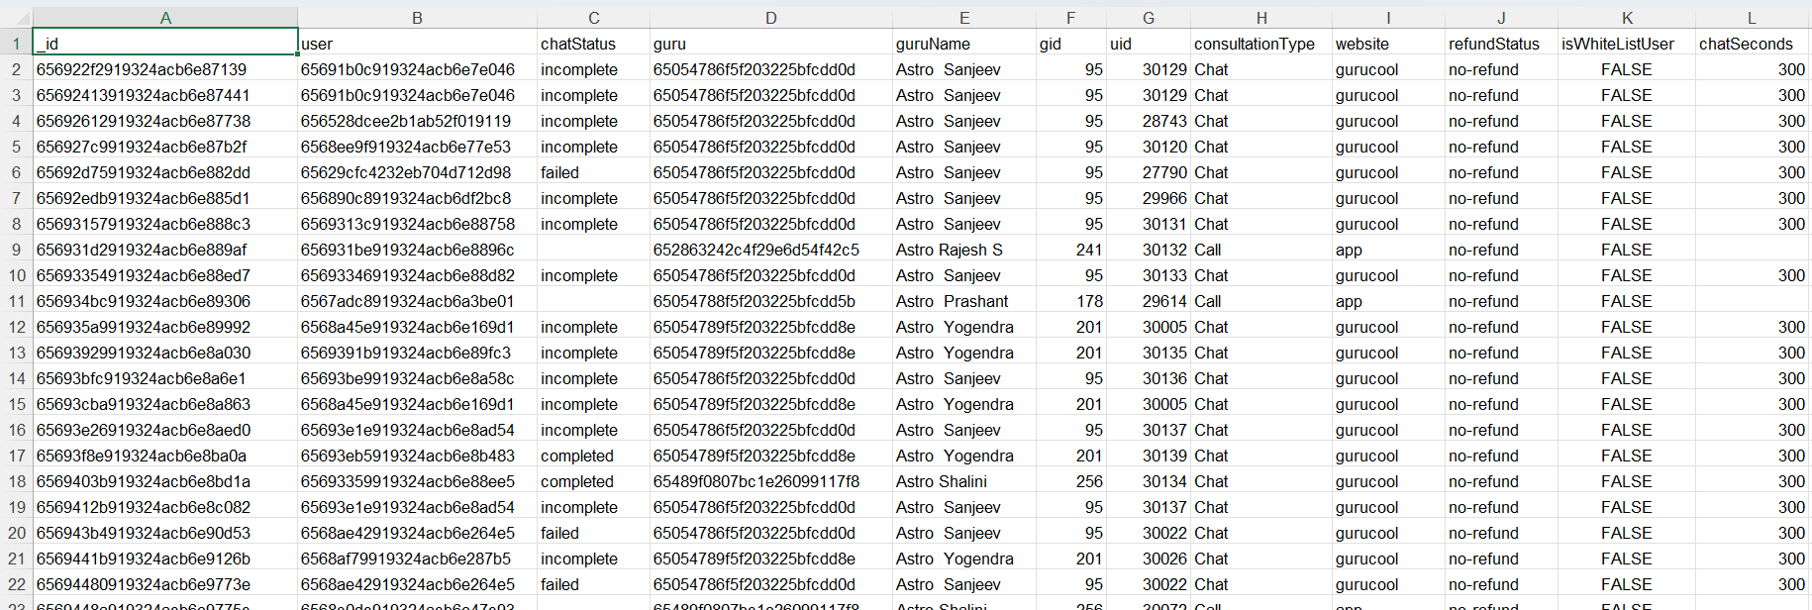
PROBLEM Statement
AstroSage has received a 1 crore investment and aims to optimize its call center operations. The goal is to determine how to allocate this investment to maximize operational efficiency, customer satisfaction, and profitability. The analysis will consider historical call data, performance metrics, and market trends to make informed decisions.

Slide 4
Attributes used
The image above displays details about AstroSage Performance, including:
_id: Unique identifier for each record.
user: User ID associated with the record.
chatStatus: Status of the chat (e.g., incomplete, failed, completed).
guru: Unique identifier for the guru.
guruName: Name of the guru.
gid: Guru ID.
uid: User ID.
consultation Type: Type of consultation (e.g., Chat, Call).
website: Source of the consultation (e.g., gurucool).
Refund Status: Indicates if the session is refundable or not (e.g., no-refund).
is WhiteList User: Boolean indicating if the user is whitelisted.
chat Seconds: Duration of the chat in seconds.
queue: Boolean indicating if the session was queued.
FreeCall: Boolean indicating if the call was free.
Free Chat: Boolean indicating if the chat was free.
CreatedAT: Original creation date and time.
updatedAt: Original update date and time.
__v: Version key.
statementEntryId: Identifier for the statement entry.
chatStartTime: Start time of the chat.
chatEndTime: End time of the chat.
timeDuration: Undefined, some technical data as per app. (Don’t use it as the duration of chat/call)
callChannel: Channel used for the call.
calIvrType: IVR type used during the call.
callStatus: Status of the call.
CallSid: Unique identifier for the call session.
amount: Amount charged for the session.
astrologerCallStatus: Status of the astrologer during the call.
astrologerOnCallDuration: Duration of the astrologer's call.
astrologersEarnings: Earnings of the astrologer from the session.
netAmount: Net amount after deductions.
region: Region of the user.
userCallStatus: Status of the user's call.
userOnCallDuration: Duration of the user's call.
rating: Rating assigned based on the session's status.

Slide 5

AstroSage Data Snapshot
Number of Active Gurus: 131 gurus, reflecting the extensive availability.
Geographical Coverage: Since customer can access it online, so its coverage area is almost all over India.
Data Cleaning and Preprocessing
Unified product categories for a consistent classification across the platform.
Normalized guru names for accuracy in analysis.
Addressed missing values in guru name data field to enhance data integrity.
This dataset allows for an in- depth understanding of AstroSage market presence and operational scope.
High-quality data is crucial for analyzing sales trends, customer behavior, and seller performance.

Slide 6

Analytical approach and Tool
Data Cleaning: Utilized functionis like TRIM, CLEAN, and Remove Duplicates to ensure data accuracy.
Data Enrichment: Enhanced the dataset with additional variables using IFElse/ArrayFormulas to cross- reference external data sources.
Descriptive Analysis: Employed Pivot Tables for sümmorizing key metrics and Identifying connection patterns across different metrics and product categories.
Customer Segmentation: Applied SORT and FILTER functions to classify customers based on consultant type and time duration.
Visualization: Created dynamic charts and dashboards for data representation, enabling interactive data exploration.

Slide 7
Avg Call Volume
The largest average call volume is on monday, which is representing ~15% of total average call volume.
Tuesday , saturday and Sunday are also an important segment for representing call volume
Also majority of Sales are through call segments and some portion of Chats.
AstroSage should consider implementing technologies and hiring skilled agents to increase the proportion of complementary and public_live_calls.

Slide 8
The Total sales generated
1. Also majority of Sales are through call segments and some portion of Chats.
2.AstroSage should consider implementing technologies and hiring skilled agents to increase the proportion of complementary and public_live_calls.

Slide 9
User Ratings
From the analysis and by seeing the chart it can be clearly seen that rating users are more compared to other ratings users.
Also highest rating i.e.rated users are less and mostly rating is averaging around 2.5-3.
So astrosage should focus on improving gurus skills and abilities
AstroSage should consider implementing technologies and increase the user ratings

Slide 10
Call and chat status
As according to chart we can see that 70% of users prefer chats and 30 % of them are using calls.
And almost negligible amount of users are preferring public_live_call and also AstroSage is providing less complementary call.
So according to analysis AstroSage should provide more amount of complementary calls.
Also more investment can be done in hiring skilled agents and also on implementing Ai-powered chat-bots and CRM technology.
Also a well-designed and systematic feedback system and automatic call routing system will attract more users for calls and overall engagements.

Slide 11
Call Distribution over hours
As according to chart we can see that highest call peak hours starts from 8 to 12.
And almost negligible amount of users are prefer calling at 0 hours.
So according to analysis AstroSage should provide more agents at night for calls.
Also more investment can be done in hiring skilled agents and also on implementing Ai-powered chat-bots and CRM technology.
Also a well-designed and systematic feedback system and automatic call routing system will attract more users for calls and overall engagements.

Slide 12
Guru rating
From the analysis and by seeing the chart it can be clearly seen that 0 rating gurus are more compared to other ratings gurus.
Also highest rating i.e. 8-rated gurus are less and mostly rating is averaging around 2-3.
So astrosage should focus on improving gurus skills and abilities
AstroSage should consider implementing technologies and hiring skilled agents to increase the user ratings

Slide 13
Avg calls per agent
From the analysis and by seeing the chart it can be clearly seen that agents are attending more calls on weekends rather than weekdays.
Also highest calls per agent gets is around 30.
The lowest call amount of calls per agents is around 20 -22.

Slide 14
Dashboard

Slide 15
Strategic Recommendations
Enhance
agent training
Omnichannel
Customer Support
AI-Powered Chatbots
Automated call route system
Prioritize Training: Invest in targeted training programs to elevate agent skills.
Embrace Technology: Explore technology upgrades to streamline operations, such as implementing a comprehensive CRM system, automated call routing, or AI-powered chatbots.

Slide 16
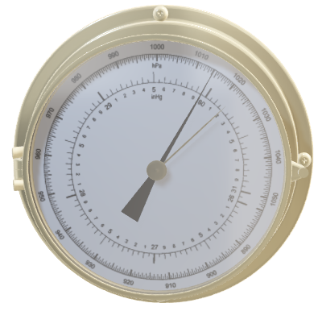
Conclusion
Today, we've explored the performance of AstroSage's call center, revealing valuable insights and identifying opportunities for improvement.
Our analysis has shown that AstroSage is handling large volume of users smoothly and precisely.
However, some of the users are still not satisfied with the AstroSage services due to which average rating is given to this, but we have discussed the solution for that solution with the help of analysis.

Slide 17


References
. Astrosage About Us Page
. Wikipedia
. Newton School Guidelines
. Raw Data

Slide 18


